Slide 1
FEEDBACK CONTROL SYSTEM
LAB # 1
Prepared By :
M. Hammad Saleem
NED University of Engineering & Technology

Slide 2
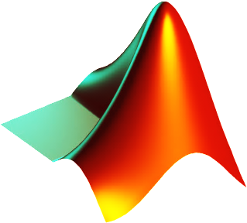
Part II: Polynomials in MATLAB
Objective:
The objective of this session is to learn how to represent polynomials in MATLAB,
Find roots of polynomials,
create polynomials when roots are known and
Obtain partial fractions.

Slide 3
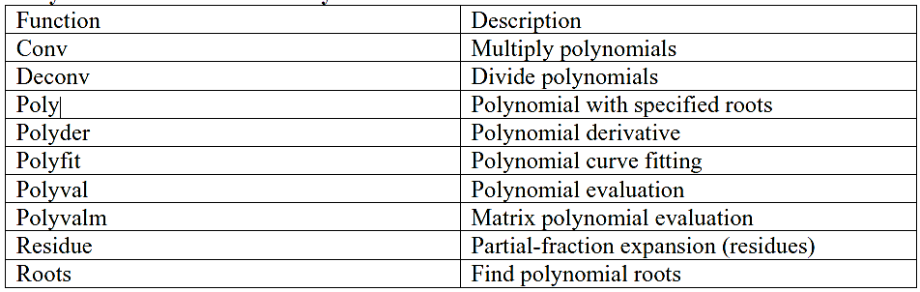
Polynomial Overview:
MATLAB provides functions for standard polynomial operations, such as polynomial roots, evaluation, and differentiation. In addition, there are functions for more advanced applications, such as curve fitting and partial fraction expansion.
Polynomial Function Summary

Slide 4

Representing Polynomials
MATLAB represents polynomials as row vectors containing coefficients ordered by descending powers. For example, consider the equation
To enter this polynomial into MATLAB, use
>> p = [1 0 -2 -5];
Polynomial Roots
The roots function calculates the roots of a polynomial:
>> r = roots(p)
r =
2.0946
-1.0473 + 1.1359i
-1.0473 - 1.1359i
By convention, MATLAB stores roots in column vectors.

Slide 5
The function poly returns to the polynomial coefficients:
>> p2 = poly(r)
p2 =
1 0 -2 -5
poly and roots are inverse functions,
Polynomial Evaluation
The polyval function evaluates a polynomial at a specified value.
To evaluate p at s = 5, use
>> polyval(p,5)
ans =
110

Slide 6
Convolution and Deconvolution
Polynomial multiplication and division correspond to the operations convolution and deconvolution.
The functions conv and deconv implement these operations.
Consider the polynomials a(s )=s²+2s+3 and b(s )=4s²+5s+6 .
To compute their product,
>> a = [1 2 3];
>> b = [4 5 6];
>> c = conv(a,b)
c =
4 13 28 27 18
Use deconvolution to divide back out of the product:
>>[q,r] = deconv(c,a)
q =
4 5 6
r =
0 0 0 0 0
b = [4 5 6];

Slide 7
Polynomial Derivatives
The polyder function computes the derivative of any polynomial.
To obtain the derivative of the polynomial.
>>p= [1 0 -2 -5]
>>q = polyder(p)
q =
3 0 -2
polyder also computes the derivative of the product or quotient of two polynomials.
For example, create two polynomials a and b:
>>a = [1 3 5];
>>b = [2 4 6];
Calculate the derivative of the product a*b by calling polyder with a single output argument:
>>c = polyder(a,b)
c =
8 30 56 38

Slide 8
Polynomial Derivatives (con’t…)
Calculate the derivative of the quotient a/b by calling polyder with two output arguments:
>>[q,d] = polyder(a,b)
q =
-2 -8 -2
d =
4 16 40 48 36
q/d is the result of the operation.
polyder also co mputes the derivative of the product or quotient of two polynomials.
For example, create two polynomials a and b:

Slide 9

Partial Fraction Expansion
‘residue’ finds the partial fraction expansion of the ratio of two polynomials.
This is particularly useful for applications that represent systems in transfer function form.
For polynomials b and a,
where
r is a column vector of residues,
p is a column vector of pole locations, and
k is a row vector of direct terms.
Consider the transfer function
>>b = [-4 8];
>>a = [1 6 8];
>>[r,p,k] = residue(b,a)
r =
-12
8
p =
-4
-2
k =
[]

Slide 10
Partial Fraction Expansion (con’t…)
Given three input arguments (r, p, and k), residue converts back to polynomial form:
>> [b2,a2] = residue(r,p,k)
b2 =
-4 8
a2 =
1 6 8

